Slide 1
Internet And Web Technology Lab IT-652
Anupam Chaudhary– 16IT8029
Sarvesh Bajaj – 16IT8035
Soham Mehrotra – 16IT8037

Slide 2
Project
Student Information System
A set of student friendly web pages that allows students to maintain their records which can be governed by one or more administrators.

Slide 3
Tools
HTML
CSS
Python
MySQL
JavaScript

Slide 4
Web Pages
Home Page
Contains the Register/Login Link for students/admin
Contains general notice and information, will be a static page.

Slide 5
Web Pages(contd..)
Registration
The User details will be redirected to the Admin Dashboard from the Registration page.
A checkbox will be kept for request for admin status.

Slide 6
Web Pages(contd..)
Login
The User Credentials will be checked from the Database which will contain a field for Role of the User. Accordingly, the User will be redirected.
Students will be redirected to the Home Page with a logged in indication.
Admin will be redirected to Admin Dashboard.

Slide 7
Web Pages(contd..)
Admin Dashboard -- I
All details of registration requests will be shown here. Upon approval, it will be added to the database with a proper role.
All User details from the database will be listed here along with a search option

Slide 8
Web Pages(contd..)
Admin Dashboard -- II
All Create and Update Functionality of Users will be available here.
The option to Delete the User will also be given.

Slide 9
Web Pages(contd..)
Student Dashboard
After Logging in as a student, the User will be redirected to the home page and the Register/Login link will be replaced by a logged in icon.

Slide 10
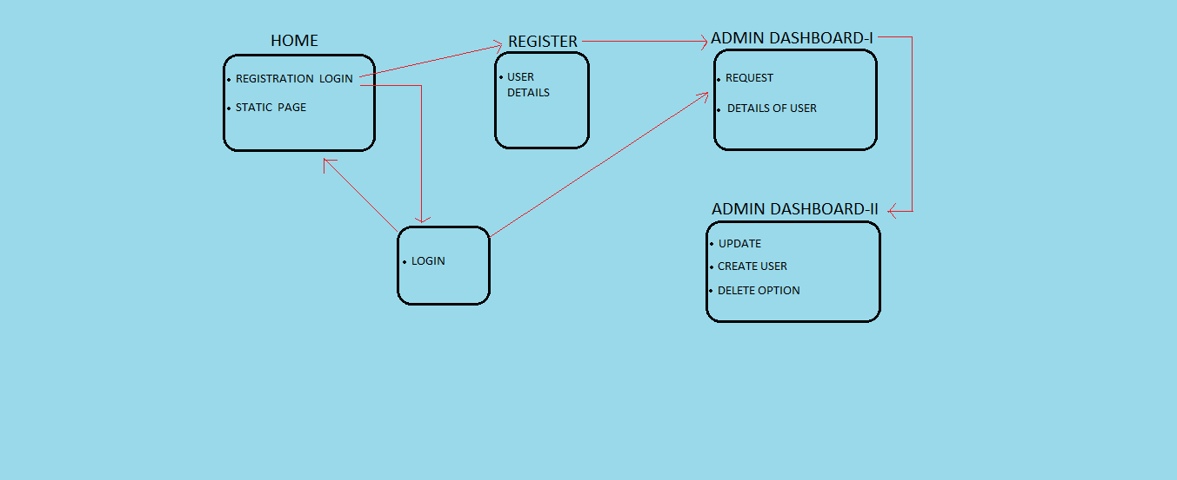
Workflow

Slide 11
Work Done (Date-wise)
29.01.18 -> Home Page Created

Slide 12
Work Division
Frontend – Home Page
Tried by all for exposure to HTML and CSS, but the best one chosen.
Presentation
Sarvesh and Soham
Flowchart
Anupam

Slide 13
Next Week Plans
Frontend
Registration and Login Page will be designed.
Backend
We will study the basic python modules required for this project and decide the fields required for the MySQL Database.

Slide 14
References
Frontend
w3schools.com

Slide 15
THANK YOU!

